Slide 1
Learn Python 17
Vishal Yelisetti

Slide 2
Agenda
Homework
Questions/concerns
Button commands
Lambda functions
Entry Widget
Grid
Homework
Build a calculator with Add/subtract/divide/multiply/square a number

Slide 3
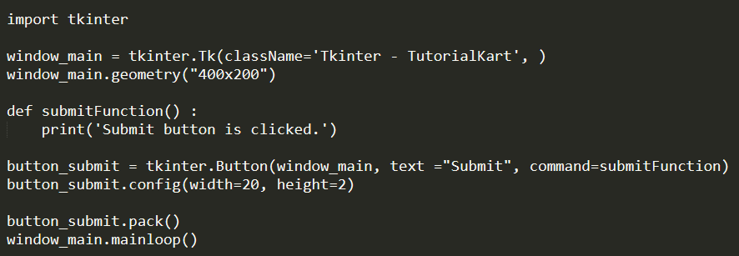
Button Commands
Tkinter Button command option sets the function or method to be called when the button is clicked.
To set a function for execution on button click, define a Python function, and assign this function name to the command option of Button.
button_submit = tkinter.Button(window_main, text ="Submit", command=submitFunction)

Slide 4
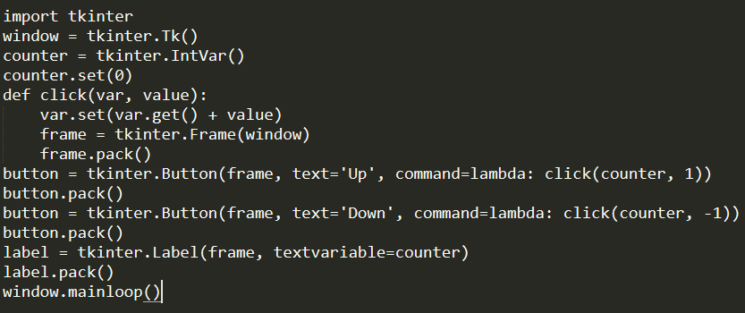
Lambda Commands
A lambda function allows us to create a one line function anywhere without giving it a name
What if we have to both the operations that are down counter and also up counter. That is we should have two actions to be performed when specified that is one which acts as a normal counter increase by 1.

Slide 5
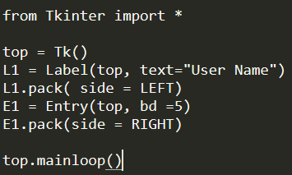
Entry Widget
w = Entry( master, option, ... )
The Entry widget is used to accept single-line text strings from a user.
If you want to display multiple lines of text that can be edited, then you should use the Text widget.
w = Entry( master, option, ... )

Slide 6
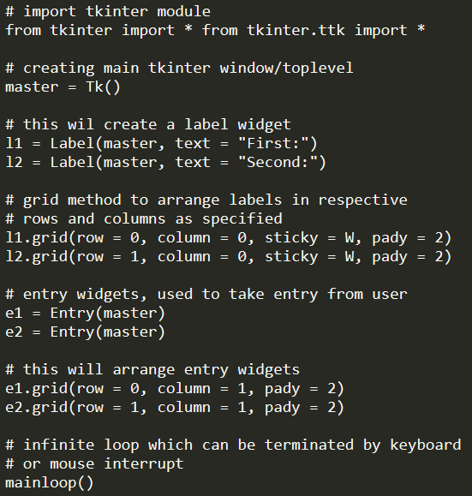
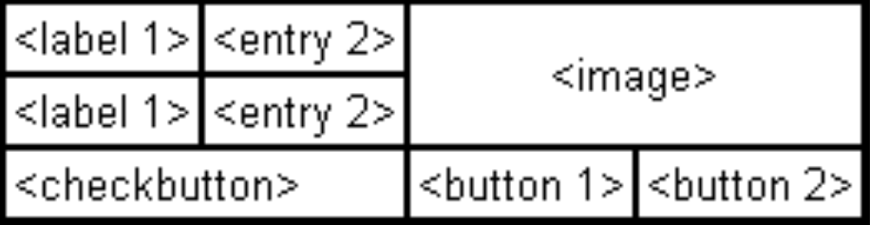
Grid Widget
Tkinter stacks widgets on top of each other and is very hard to align the GUI the way we want
The Grid geometry manager puts the widgets in a 2-dimensional table. The master widget is split into a number of rows and columns, and each “cell” in the resulting table can hold a widget.
Creating something like the picture below is not possible, without grid:

Slide 7
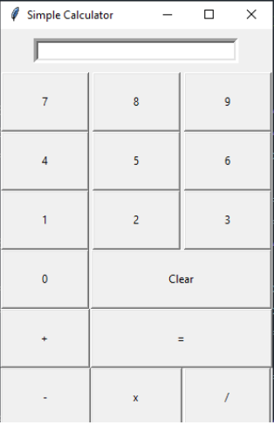
Homework
Build a calculator with Add/subtract/divide/multiply/square a number
Upload the file to your Github pages

Slide 8
References
Use this link to help you create your GUI
Has many examples and great explanations on how to create GUI
Python - GUI Programming (Tkinter) - Tutorialspoint

